Slide 1
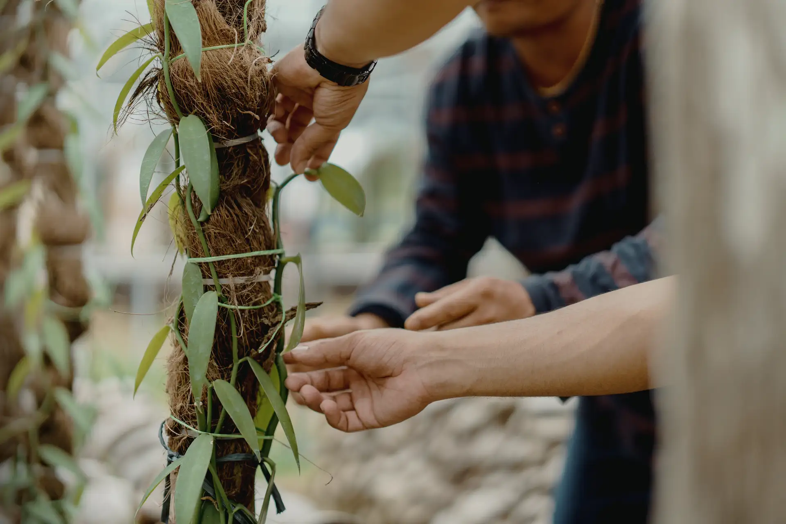



ArtsFAS (Arts For All Seasons)Grant 2026
[Company/Organisation logo]
[Company/Organisation name]

Slide 2
  ABOUT [COMPANY/ORGANISATION NAME]
Read me
Please include your organisation logo here
[please move me out of the way to copy/edit the template]
When your company/ organisation was formed?
What is your company/ organisation’s mission?
What are the main activities does your company/organisation do to fulfil its’ mission?
What is the organisational structure of your company/ organisation?
Social media/ website link:
(Maximum page for this content is 1 pages)

Slide 3
  ArtsFAS 2026:
  [ORGANISATION NAME]
  [PROJECT TITLE]
Tell us about the project you are proposing for Hasanah’s funding. Including but not limited to:
Project Title:
Brief summary of the project: (Objectives)
Intention of Project: (Max 2) Highlight the applicable option in yellow | Knowledge & Skills Transmission Community-Led Heritage Documentation & Cultural Knowledge Preservation Cultural Leadership & Capacity Building Cultural Showcases & Public Platforms
Duration: | Months (Month Year- Month Year)
Location(s): (Max 4)
Beneficiaries: (Direct/ Indirect)
Expected key deliverables/ Result by the end of the project:
Total Funding Request: | RM
(Maximum page for this content is 1 pages)

Slide 4
  IMPACT INDICATORS & TARGETS
Problem Statement | Objective/Intervention | Expected Output(s) | Output Indicator(s) | Baseline (B) | Project Targets
 |  |  |  |  | B + (according to project outline)
State the problem(s) that your company/organisation trying to solve | State how will this project solve the problem as stated in the problem statement | State the outputs your organisation expects to create based on the intervention | State indicators to measure expected outputs | (if intervention has been implemented before, this should not be zero)
Example 1 : The aging master artisan in heritage arts has no successors, leading to a lack of continuity and the gradual loss of the heritage. | Example 1: Facilitate training for new, interested young artisans under the guidance of this master artisan for knowledge transfer and providing platforms for practice or opportunities to access the market. | Example 1 (Output): Exposed to and enhanced knowledge of the heritage arts, while managing to actively practice them and can generate an income from their craft. | Example 1: Number of participants trained (Output) Artworks developed under the mentorship/training (Outcome) Total sales generated from participants artworks (Outcome) |  | Example 1: 10 students acquired skills and are equipped to continue the trade.
Example 2 : Many students are interested in Ronggeng Melayu dance, but art teachers have limited exposure and training to teach this heritage artform effectively. | Example 2: To strengthen the skills and knowledge of art teachers in the dance, enabling them to train students and sustain the artform within the school curriculum. | Example 2 (Outcome): Art teachers are equipped to teach Ronggeng Melayu dance, creating structured learning opportunities for students and promoting the heritage artform. | Example 2: Number of art teachers trained (Output) Number of students taught by the trained teachers (Outcome) Improved skills (Outcome) |  | Example 2 5 art teachers trained, who will in turn teach at least 50 students.
Read me
The purpose of this slide is to:
(i) convey your impact narrative; (ii) how you will be measuring impact; and
(iii) indicate your target per indicator
[please move me out of the way to copy/edit the template]
*Note: Outputs are deliverables resulting from project activities. They include goods, products, services, knowledge and skills that are largely within a control of an organization. For example, people increase in knowledge and skills.
Outcomes are the expected change(s) in behaviors, systems, policies or institutions as a result of project outputs and activities. For example, participants adopting new behaviors or skills promoted by the project.

Slide 5
  IMPACT INDICATORS & TARGETS
Problem Statement | Objective/Intervention | Expected Output(s) | Output Indicator(s) | Baseline (B) | Project Targets
 |  |  |  |  | B + (according to project outline)
State the problem(s) that your company/organisation trying to solve | State how will this project solve the problem as stated in the problem statement | State the outputs your organisation expects to create based on the intervention | State indicators to measure expected outputs | (if intervention has been implemented before, this should not be zero)
Example 3: The heritage art of Gasing Pangkah is not documented, putting national cultural heritage at risk of being lost. | Example 3: To document the making of Gasing Pangkah from the beginning through books, videos, or other media, and to publish or archive the materials in collaboration with government bodies, ensuring the preservation and accessibility of the heritage for future generations. | Example 3 (Output): Comprehensive documentation of the Gasing Pangkah, including visual and written records, archived and/or published for reference and public access. | Example 3: Number of documentation materials produced (books, videos, digital content) (Output) Number of publications, archives, or official postings with JKKN or government bodies (Outcome) Accessibility or reach of the documented heritage content (Outcome) |  | Example 3: 1 book and 1 video documentary produced and archived/published with relevant government institutions, ensuring the heritage artform is preserved and accessible.
Read me
The purpose of this slide is to:
(i) convey your impact narrative; (ii) how you will be measuring impact; and
(iii) indicate your target per indicator
[please move me out of the way to copy/edit the template]
*Note: Outputs are deliverables resulting from project activities. They include goods, products, services, knowledge and skills that are largely within a control of an organization. For example, people increase in knowledge and skills.
Outcomes are the expected change(s) in behaviors, systems, policies or institutions as a result of project outputs and activities. For example, participants adopting new behaviors or skills promoted by the project.

Slide 6
  HISTORICAL TRACK RECORD
Please provide any related past achievement (at least for the past 1 year) that are similar to the proposed project to display your company/organisation's experience in the related field. You may refer the template below. Maximum 3 projects.
Past Credential
Project Name: | Please insert project name.
Project Description: | Please describe the project including the project year executed, duration, budget, stakeholders and funders (if any).
Project Impact/ Achievement: | Please provide what the outcome of the project was (50 words only).
Read me
The purpose of this slide is to show your organisation’s experience and accomplishments (if any).
[please move me out of the way to copy/edit the template]

Slide 7
  PROJECT TEAM STRUCTURE & CREDENTIALS
Please highlight the team member’s roles and responsibilities for the proposed project. | Head of the Organisation For Signing the Grant Documents | Authorised Witness For Signing the Grant Documents | Program Manager | Program Manager/ Team
 | Core team member’s photo | Core team member’s photo | Core team member’s photo | Core team member’s photo
Full Name (NRIC):
Email Address:
Job Title:
Related Experiences to the projects
Read me
The purpose of this slide is to illustrate the roles and responsibilities of the team members for the proposed projects.
[please move me out of the way to copy/edit the template]

Slide 8








THANK YOU
Yayasan Hasanah Level 2, Block A
Dataran PHB Saujana Resort, Seksyen U2, 40150 Shah Alam Selangor Darul Ehsan
connect@hasanah.org.my
03-5870 4333 | 03-5870 4355
yayasanhasanah.org
yhanasahmy
yayasanhasanah
yayasan_hasanah
yayasan-hasanah

